Slide 1
Abstract Windowing Toolkit (AWT)
12 Marks

Slide 2
Course Outcome
To design and develop GUI programs using AWT and Swing

Slide 3
Unit Outcome
Develop grphical user interface(GUI)programs using AWT components for the given problem.
Create frame window with the specified AWT components
Arrange the GUI components using specified layout manager
Develop a program using menu and Dialog boxes for the given problem

Slide 4
Contents..
Component, Container, Window, Frame, Panel
Creating windowed programs and applets
AWT controls & Layout Managers
3.1 use of AWT controls: Labes,Buttons,checkbox,checkbox group,scroll bars,text field, text area
3.2 use of Layout Managers:
flowLayout,borderLayout,gridLayout,cardLayout,gridbagLayout,menus,menubars,dialog boxes,file dialog.

Slide 5
Introduction
Whenever an application (or software) is created, the user can work with it in two ways.
CUI (Character User Interface)
GUI (Graphical User Interface)

Slide 6
CUI
The first way is where the user can remember some commands on which the application is built and type those commands to achieve the respective tasks.
For example, the user may have to type a PRINT command to send a file contents to a printer.
Here, the user should know the syntax and correct usage of the PRINT command.
Then only he can interact with the application properly.
This is called CUI (Character User Interface) since the user has to use characters or commands to interact with the application.
Disadvantage:
User has to remember several commands and their use with correct syntax.
Not user-friendly. A person who does not know any thing about computers will find this CUI very difficult

Slide 7
GUI
The user need not remember any commands but interacts with any application by clicking on some images or graphics.
For example, if the user wants to print a file, he can click on a printer image and the rest of the things will be taken care of by the application.
The user has to tell how many copies he wants and printing continues. This is very easy for the user since' the user remembers only some symbols or images like a magnifying glass symbol for searching, a briefcase symbol for a directory, etc.
This environment where the user can interact with an application through graphics or images is called GUI (Graphics User Interface).

Slide 8
GUI Advanatges
It is user-friendly.
It adds attraction and beauty to any application by adding pictures, colors, menus, animation
It is possible to simulate the real life objects using GUI.
GUI eliminates the need of user training.
GUI helps to create graphical components like push buttons, radio buttons, check boxes, etc. and use them effectively in our programs.

Slide 9
AWT Introduction
Java AWT (Abstract Windowing Toolkit) is an API to develop GUI or window-based application in java.
Java AWT components are platform-dependent i.e. components are displayed according to the view of operating system. AWT is heavyweight i.e. its components uses the resources of system.
The java.awt package provides classes for AWT api such as TextField, Label, TextArea, RadioButton, CheckBox, Choice, List etc

Slide 10
Why AWT is platform dependent? Java AWT calls native platform (Operating systems) subroutine for creating components such as textbox, checkbox, button etc. For example an AWT GUI having a button would have a different look and feel across platforms like windows, Mac OS & Unix, this is because these platforms have different look and feel for their native buttons and AWT directly calls their native subroutine that creates the button. In simple, an application build on AWT would look like a windows application when it runs on Windows, but the same application would look like a Mac application when runs on Mac OS.
AWT is rarely used now days because of its platform dependent and heavy-weight nature. AWT components are considered heavy weight because they are being generated by underlying operating system (OS). For example if you are instantiating a text box in AWT that means you are actually asking OS to create a text box for you.
Swing is a preferred API for window based applications because of its platform independent and light-weight nature. Swing is built upon AWT API however it provides a look and feel unrelated to the underlying platform. It has more powerful and flexible components than AWT. In addition to familiar components such as buttons, check boxes and labels, Swing provides several advanced components such as tabbed panel, scroll panes, trees, tables, and lists. We will discuss Swing in detail in a separate tutorial.

Slide 11
Component
A component is an object having a graphical representation that can be displayed on the screen and that can interact with the user.
Examples of components are the buttons, checkboxes, and scrollbars of a typical graphical user interface.
public abstract class Component extends Object

Slide 12
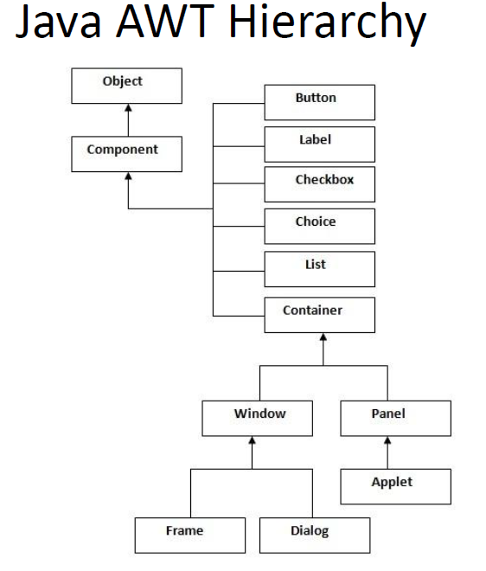

Slide 13
Container
A container is a component which can contain other components inside itself. It is also an instance of a subclass of java.awt.Container.
java.awt.Container extends java.awt.Component so containers are themselves components.
In general components like buttons, textfields, labels etc are contained in a container.
For eg: An applet is a container.
Other containers include windows, frames, dialogs, and panels extends container class.
Containers may contain other containers.
Every container has a LayoutManager that determines how different components are positioned within the container.
Applets provide a ready-made container and a default LayoutManager, a FlowLayout.

Slide 14
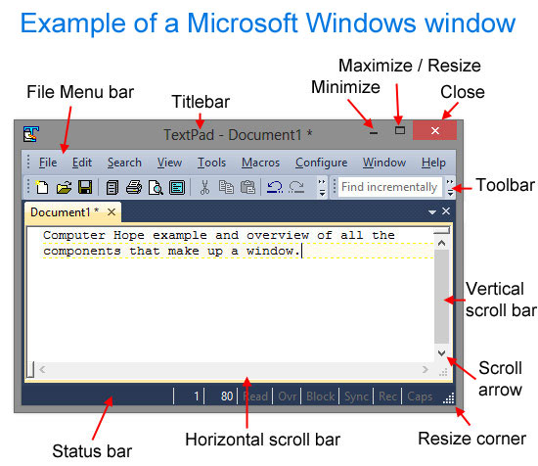

Slide 15
Window
The class Window is a top level window with no border and no menubar.
A top-level window is not contained within any other object; it sits directly on the desktop
It uses BorderLayout as default layout manager
You must use frame, dialog or another window defined as its owner when it's constructed.
Generally, we don’t create Window objects directly. Instead, we use a subclass of Window called Frame.
Class Declaration:
public class Window extends Container

Slide 16
Frame
The Frame is the container that contain title bar,borders and menu bars.
It can have other components like button, textfield etc.
This is most widely used container while developing an application in AWT
It uses BorderLayout as default layout manager
Class Declaration:
public class Frame extends Window

Slide 17
Dialog
The Dialog control represents a top level window with a border and a title used to take some form of input from the user.
It inherits the Window class.
Unlike Frame, it doesn't have maximize and minimize buttons.
The default layout for a dialog is BorderLayout
Class Declaration:
public class Panel extends Container

Slide 18
Panel
The Panel is the container that doesn't contain title bar ,menu bars or borders.
It is a generic container for holding components.
An instance of the Panel class provides a container to which to add components like button, textfield etc.
The default layout manager for a panel is the FlowLayout layout manager.
Class Declaration:
public class Panel extends Container

Slide 19
Applet
When you run an applet using an applet viewer, the applet viewer provides the title and border
An instance of the Applet class provides a container to which to add components like button, textfield etc.
The default layout manager for a panel is the FlowLayout layout manager.
Applet is also mostly used for creating window
Class Declaration:
public class Applet extends Panel

Slide 20
Difference between Applet and Frame
Sr. No. | Applet | Frame
1 | Applet is a java program that can be embedded in a web page,i.e it is a program that can run on Html web page | Frame is an application that run on local machine
2 | Applet is subclass of panel class | frame is subclass of window class
3 | Applet has no menu bar | frame has menu bar
4 | Applet has no border | but frame has border
5 | Applet has no title bar | frame has title bar
6 | Applet is web based application | frame is standalone application
7 | Applet has default layout is FlowLayout | frame has default layout is border layout

Slide 21
Container methods
Component add(Component comp)
Appends the specified component to the end of this container.
Component add(Component comp, int index)
Adds the specified component to this container at the given position.
void add(Component comp, Object constraints)
Adds the specified component to the end of this container.
void add(Component comp, Object constraints, int index)
Adds the specified component to this container with the specified constraints at the specified index.
void addContainerListener(ContainerListener l)
Adds the specified container listener to receive container events from this container.
void setLayout(LayoutManager mgr)
Sets the layout manager for this container.
LayoutManager getLayout()
Gets the layout manager for this container.

Slide 22
Container methods (cont’d)
void remove(Component comp)
Removes the specified component from this container.
void remove(int index)
Removes the component, specified by index, from this container.
void removeAll()
Removes all the components from this container.
void removeContainerListener(ContainerListener l)
Removes the specified container listener so it no longer receives container events from this container.

Slide 23
Use of AWT controls
Controls are components that allow a user to interact with your application in various ways—for example, a commonly used control is the push button

Slide 24
Label
The easiest control to use is a label
The label control is an object of Label and it contains a string, which it displays.[caption]
Label is a passive control because it does not create any event when accessed by the user.
A label displays a single line of read-only text.
However, the text can be changed by the application programmer, but cannot be changed by the end user in any way
Class Declaration
public class Label extends Component implements Accessible
Field
static int CENTER -- Indicates that the label should be centered.
static int LEFT -- Indicates that the label should be left justified.
static int RIGHT -- Indicates that the label should be right justified

Slide 25
Label cont’d..
Class Constructors
Label() Constructs an empty label
Label(String text)
Constructs a new label with the specified string of text, left justified
Label(String text, int alignment)
Constructs a new label that presents the specified string of text with the specified alignment.
The value of alignment must be one of these three constants: Label.LEFT, Label.RIGHT, or Label.CENTER.
Class Methods
String getText() Gets the text of this label.
void setText(String text) Sets the text for this label to the specified text
void setAlignment(int how) Set the alignment of the string
int getAlignment() Get the alignment of the string
For example:
FrameLabel.java FrameLabelMain.java

Slide 26
Button Class
Button is also called as push button
Push buttons are objects of type Button
Button is a control component that has a label and generates an event when pressed.
Class Declaration
public class Button extends Component implements Accessible
Class Constructors
Button() Constructs a button with an empty string for its label
Button(String text) Constructs a new button with specified label
Methods
void setLabel(String label) Sets the button's label to be the specified string
String getLabel() Gets the label of this button

Slide 27
CheckBox Class
Checkbox control is used to turn an option on(true) or off(false).
There is label for each checkbox representing what the checkbox does.
The state of a checkbox can be changed by clicking on it
Check boxes can be used individually or as part of a group. Check boxes are objects of the Checkbox class
Class Constructors
Checkbox()
Creates a check box with an empty string for its label and state is unchecked
Checkbox(String label)
Creates a check box with the specified label and state is unchecked.
Checkbox(String label, boolean state)
Creates a check box with the specified label and sets the specified state.
Checkbox(String str, boolean on, CheckboxGroup cbGroup)
Creates a check box whose label is specified by str and whose group is specified by cbGroup

Slide 28
Checkbox methods
void setLabel(String Label)
It sets the checkbox’s label to the given string
String getLabel()
It gets the label for the checkbox.
void setState(boolean state)
It sets the state of the checkbox to the given state
boolean getState()
It determines whether the checkbox is selected or not.
5. void setCheckboxGroup(Checkboxgroup G)
It sets the checkbox to the given checkboxgroup.

Slide 29
Radio Button
It is possible to create a set of mutually exclusive check boxes in which one and only one check box in the group can be checked at any one time.
These check boxes are often called radio buttons
The CheckboxGroup class is used to group the set of checkbox
Constructors
CheckboxGroup()
Creates a new instance of CheckboxGroup
Class methods
1. void setSelectedCheckbox(Checkbox box)
Sets the currently selected check box in this group to be the specified check box
2. Checkbox getSelectedCheckbox()
Gets the current choice from this check box group

Slide 30
TextField
The component can display single line of Text
Constructors
TextField()
It constructs a new text field
TextField(int columns)
It constructs new,empty textfield with the indicated no. of columns
TextField(String text)
It constructs the new textfield with the indicated text
TextField(String text,int columns)
It constructs the textfield, with the indicated text and indicated no. of columns.

Slide 31
TextField Methods
1. void setColumns(int columns)
It sets the no. of columns in the text field
2. int getColumns()
It gets the no. of columns in the text field
3. void setText(String text)
It sets the text in this text field to the indicated text.
4. String getText()
It retrieve the text in the text field
5. void setEchochar(char c)
It set the echo char for the textfield
6. char getEchoChar()
It gets the character to be used for echoing.

Slide 32
TextArea
TextArea is much like a two dimensional text field
We can display the whole document in text Area
We can also use scroll bars to move through text
Java.awt.TextArea is a subclass of java.awt.Component

Slide 33
TextArea constructors
TextArea()
Constructs a new text area with the empty string as text.
TextArea(int rows, int columns)
Constructs a new text area with the specified number of rows and columns and the empty string as text.
TextArea(String text)
Constructs a new text area with the specified text.
TextArea(String text, int rows, int columns)
Constructs a new text area with the specified text, and with the specified number of rows and columns.
TextArea(String text, int rows, int columns, int scrollbars)
Constructs a new text area with the specified text, and with the rows, columns, and scroll bar visibility as specified.

Slide 34
TextArea methods
void append(String str)
Appends the given text to the text area's current text.
int getColumns()
int getRows()
void setColumns(int)
void setRows(int)
int getScrollbarVisibility()
Returns an enumerated value that indicates which scroll bars the text area uses.
public static final int SCROLLBARS_BOTH 0
public static final int SCROLLBARS_HORIZONTAL_ONLY 2
public static final int SCROLLBARS_NONE 3
public static final int SCROLLBARS_VERTICAL_ONLY 1
For Example:
TextAreaExample.java
TextAreaExampleMain.java

Slide 35
Choice
The Choice class presents a pop-up menu of choices. The current choice is displayed as the title of the menu.
Constructor
Choice()
Creates a new choice menu.

Slide 36
void add(String item)
Adds an item to this Choice menu.
String getItem(int index)
Gets the string at the specified index in this Choice menu.
int getItemCount()
Returns the number of items in this Choice menu.
ItemListener[] getItemListeners()
Returns an array of all the item listeners registered on this choice.
int getSelectedIndex()
Returns the index of the currently selected item.
String getSelectedItem()
Gets a representation of the current choice as a string
void insert(String item, int index)
Inserts the item into this choice at the specified position.

Slide 37
void remove(int position)
Removes an item from the choice menu at the specified position.
void remove(String item)
Removes the first occurrence of item from the Choice menu.
void removeAll()
Removes all items from the choice menu.
void removeItemListener(ItemListener l)
Removes the specified item listener so that it no longer receives item events from this Choice menu

Slide 38
List Class
The List component presents the user with a scrolling list of text items.
The list can be set up so that the user can choose either one item or multiple items.
Constructor and Description
List()
Creates a new scrolling list.
List(int rows)
Creates a new scrolling list initialized with the specified number of visible lines.
List(int rows, boolean multipleMode)
Creates a new scrolling list initialized to display the specified number of rows.

Slide 39
List methods
void add(String item)
Adds the specified item to the end of scrolling list.
void add(String item, int index)
Adds the specified item to the the scrolling list at the position indicated by the index.
String getItem(int index)
Gets the item associated with the specified index.
int getItemCount()
Gets the number of items in the list.
ItemListener[] getItemListeners()
Returns an array of all the item listeners registered on this list.
String[] getItems()
Gets the items in the list.

Slide 40
int getSelectedIndex()
Gets the index of the selected item on the list,
int[] getSelectedIndexes()
Gets the selected indexes on the list.
String getSelectedItem()
Gets the selected item on this scrolling list.
String[] getSelectedItems()
Gets the selected items on this scrolling list.
boolean isIndexSelected(int index)
Determines if the specified item in this scrolling list is selected.
boolean isMultipleMode()
Determines whether this list allows multiple selections.
void select(int index)
Selects the item at the specified index in the scrolling list.
void setMultipleMode(boolean b)
Sets the flag that determines whether this list allows multiple selections.

Slide 41
Peers
Java programs always have the look and feel of the platform they are running on.
If you create your program on a UNIX platform and deliver it to Microsoft Windows users, your program will have Motif’s look and feel while you’re developing it, but users will see Microsoft Windows objects when they use it.
Java accomplishes this through a peer architecture
There are several layers of software between your Java program and the actual screen

Slide 42
Peer(cont’d)
Let’s say you are working with a scrollbar.
On your screen, you see the scrollbar that’s native to the platform you’re using.
This system-dependent scrollbar is the “peer” of the Java Scrollbar object.
The peer scrollbar deals with events like mouse clicks etc, passing along whatever it deems necessary to the corresponding Java component.
The peer interface deﬁnes the relationship between each Java component and its peer; it is what allows a generic component (like a Scrollbar) to work with scrollbars on different platforms

Slide 43
Layout Manager
Layout Manager automatically arranges the controls within a window with the help of certain algorithms
It is an object which implements LayoutManager interface.
It determines the size and position of the components within a container.
Each object of the components is associated with the layout manager.
setLayout() method is used for setting the layout manager.
void setLayout(LayoutManger layoutManger) where layoutManager is referred to the desired layout manager.

Slide 44
LayoutManager
Layouts allow you to format components on the screen in a platform-independent way.
Without layouts, you would be forced to place components at explicit locations on the screen, creating obvious problems for programs that need to run on multiple platforms.
There’s no guarantee that a TextArea or a Scrollbar or any other component will be the same size on each platform; in fact, you can bet they won’t be.
In an effort to make your Java creations portable across multiple platforms, Sun created a LayoutManager interface that deﬁnes methods to reformat the screen based on the current layout and component sizes

Slide 45
LayoutManager
Layout managers try to give programs a consistent and reasonable appearance, regardless of the platform, the screen size, or actions the user might take
The standard JDK provides ﬁve classes that implement the LayoutManager interface
They are
FlowLayout
GridLayout
BorderLayout
CardLayout
GridBagLayout

Slide 46
Default Layout Manager
If there is no setLayout() defined, then default layout manager is used.
Window uses BorderLayout as default layout manager
panel uses FlowLayout as default layout manager.
If you pass null for layoutManager, then it disables the layout manager.
You need to determine the size and the position of the component manually.
For this you have to use setBounds() method.
setBounds(int x, int y, int width, int height)

Slide 47
FlowLayout
The FlowLayout is the default layout for the Panel class, which includes its most famous subclass, Applet
When you add components to the screen, they ﬂow left to right (centered within the applet) based upon the order added and the width of the applet
When there are too many components to ﬁt, they “wrap” to a new row, similar to a word processor with word wrap enabled
If you resize an applet, the components’ ﬂow will change based upon the new width and height

Slide 48
FlowLayout constructors
1. FlowLayout()
It constructs a new FlowLayout with centered alignment and default 5 pixels horizontal and vertical gaps
2. FlowLayout(int align)
It constructs a new FlowLayout with given alignment and default 5 pixels horizontal and vertical gaps
3. FlowLayout(int align,int hgap,int vgap)
It constructs a new FlowLayout with given alignment and given horizontal and vertical gaps

Slide 50
Methods of FlowLayout class
void addLayoutComponent(String name,Component comp)
void removeLayoutComponent(Component comp)
void setAlignment(int align) – CENTER,LEFT,RIGHT,LEADING & TRALING
public static final int LEFT 0
public static final int CENTER 1
public static final int RIGHT 2
public static final int LEADING 3
public static final int TRAILING 4
int getAlignement()
void setHgap(int hgap)
int getHgap()
void setVgap(int vgap)
int getVgap()
For Example:
FlowLayoutExample.java
FlowLayoutExampleMain

Slide 51
GridLayout
The GridLayout is widely used for arranging components in rows and columns.
As with FlowLayout, the order in which you add components is relevant.
You start at left of row one, column one, move across the row until it’s full, then continue on to the next row.
Each component is given the same size and dimensions.
However, unlike FlowLayout, the underlying components are resized to ﬁll the row-column area, if possible
GridLayout can reposition or resize objects after adding or removing components
Whenever the area is resized, the components within it are resized

Slide 53
GridLayout Constructors
GridLayout()
It creates the grid layout with 1X1
GridLayout(int rows,int cols)
It creates the grid layout with rowsXcols
GridLayout(int rows,int cols,int hgap,int vgap )
It creates the grid layout with rowsXcols as well as given amount of spacing

Slide 54
Methods of GridLayout class
void addLayoutComponent(String name,Component comp)
void removeLayoutComponent(Component comp)
void setHgap(int hgap)
int getHgap()
void setVgap(int vgap)
int getVgap()
void setColumns(int cols)
int getColumns()
void setRows(int rows)
int getRows()
For Example:
GridLayoutExampleMain.java
GridLayoutExample.java

Slide 55
BorderLayout
BorderLayout is one of the more unusual layouts provided.
It is the default layout for Window, along with its children, Frame and Dialog.
BorderLayout provides ﬁve areas to hold components.
These areas are named after the four different borders of the screen, North, South, East, and West, with any remaining space going into the Center area.
When you add a component to the layout, you must specify which area to place it in.
The order in which components are added to the screen is not important, although you can have only one component in each area.

Slide 57
BorderLayout constructors
BorderLayout()
It creates the new border layout without any gap between the components.
BorderLayout(int hgap,int vgap)
It constructs a border layout with the indicated gaps between components.
Methods of BorderLayout
void addLayoutComponent(String name,Component comp)
void removeLayoutComponent(Component comp)
void setHgap(int hgap)
int getHgap()
void setVgap(int vgap)
int getVgap()

Slide 58
CardLayout
The CardLayout is a bit on the strange side.
A CardLayout usually manages several components, displaying one of them at a time and hiding the rest.
All the components are given the same size.
Usually, the CardLayout manages a group of Panels (or some other container), and each Panel contains several components of its own.

Slide 59
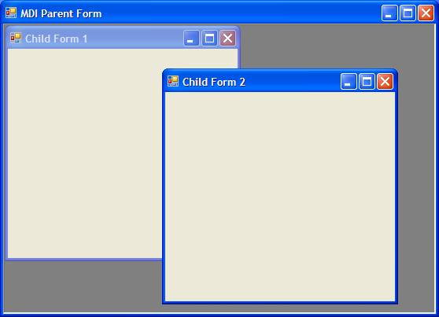
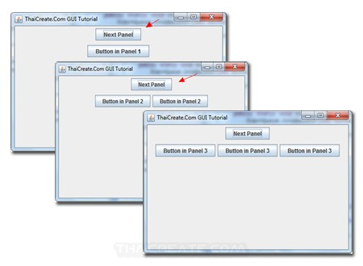

Slide 60
CardLayout
Card layout Manager displays the container you pass to it as cards.
We assign name to each card and then move from one card to another by using show() method.
Besides show() method , we can also use first,last,next and previous methods of the CardLayout class to display the specific class.
Constructors
CardLayout()
It creates a new card layout
CardLayout(int hgap,int vgap)
It creates a new card layout with the given horizontal and vertical gaps

Slide 61
Methods of CardLayout
void addLayoutComponent(String name,Component comp)
void removeLayoutComponent(Component comp)
void setHgap(int hgap)
int getHgap()
void setVgap(int vgap)
int getVgap()
void first(Container Parent)
void last(Container Parent)
void next(Container Parent)
void previous(Container Parent)

Slide 62
GridBagLayout
GridBagLayout is the most sophisticated and complex of the layouts provided in the development kit.
The Grid bag layout (like grid layout) arranges components into a grid of rows and columns, but lets you specify a number of settings to fine-tune how the components are sized and positioned within the cells.
Unlike the grid layout, the rows and columns are not constrained to be a uniform size.
With the GridBagLayout, you can organize components in multiple rows and columns, stretch speciﬁc rows or columns when space is available, and anchor objects in different corners.

Slide 63
GridBagLayout(cont’d)
The set of cells a component spans can be referred to as its display area.
A component's display area and the way in which it fills that display area are defined by a set of constraints that are represented by the GridBagConstraints object
The GridBagConstraints object is initialized with a set of default values, each of which can be customized to change the way the component will be layed out within the gridbag

Slide 65
GridBagConstraints.gridx and GridBagConstraints.gridy
The gridx and gridy settings indicate at which row (gridx) or column (gridy) the component should be located.
The top row is gridx=0, and the left-most column is gridy=0.
The value for gridx/gridy can either be an integer corresponding to the explicit row/column or the value GridBagConstraints.RELATIVE, which indicates that the component should be placed in the row/column subsequent to the row/column where the last component was placed.
For example, when adding components to a row, gridx=GridBagConstraints.RELATIVE places the component to the right of the component just added to the row. If a component was just added to Row 2 in Column 1, the next component is added to Row 2 in Column 2.
When adding components to a column, gridy=GridBagConstraints.RELATIVE places the component below the component just added to the column. If a component was just added to Column 0 in Row 1, the next component is added to Column 0 in Row 2.

Slide 66
GridBagConstraints.gridwidth & GridBagConstraints.gridheight
The gridwidth and gridheight settings indicate the number of cells in the display area for a component.
The default values are gridwidth=1 and gridheight=1 meaning that by default components are one column wide (gridwidth), and one row high (gridheight).
You can make a component two columns wide with gridwidth=2 or three rows high with gridheight=3.
Setting gridwidth to GridBagConstraints.REMAINDER indicates the component should take up the remaining number of cells in the row.
Setting it to GridBagConstraints.RELATIVE indicates that the component should take up all the remaining cells in the row except the last one.
When you specify a component as the last or next-to-last component in a row, you can give it a gridheight value greater than one so the component spans multiple rows.
However, in this case, there is no way to make the component wider than one column when it is the last or next-to-last component in the row.

Slide 67
GridBagConstraints.weightx & GridBagConstraints.weighty
When the user resizes a window using a grid bag layout, the weightx and weighty settings determine how the components resize.
By default the settings are weightx=0 and weighty=0, which means that when the window is resized, the components stay grouped together in the center of the container.
If you give weightx>0, the components expand in the x direction (horizontally).
If you give weighty>0, the components expand in the y direction (vertically).

Slide 68
GridBagConstraints.fill
The fill settings determines how a component fills the display area defined by gridx/gridy/gridwidth/gridheight.
The fill can be set to the following values:
GridBagConstraints.HORIZONTAL: The component expands horizontally to fill the entire width of its display area.
GridBagConstraints.VERTICAL: The component expands vertically to fill the entire height of its display area.
GridBagConstraints.BOTH: The component expands to completely fill the entire display area.
GridBagConstraints.NONE: The component is sized to its ideal size regardless of the size of the display area.

Slide 69
GridBagConstraints.anchor
When a component is smaller than its display area, you can anchor the component in the following locations within its display area:
anchor=GridBagConstraints.CENTER (the default) anchor=GridBagConstraints.NORTH (top) anchor=GridBagConstraints.NORTHEAST (top-right) anchor=GridBagConstraints.EAST (right) anchor=GridBagConstraints.SOUTHEAST (bottom-right) anchor=GridBagConstraints.SOUTH (bottom) anchor=GridBagConstraints.SOUTHWEST (bottom-left) anchor=GridBagConstraints.WEST (left) anchor=GridBagConstraints.NORTHWEST(top-left)

Slide 70
GridBagConstraints.ipadx and GridBagConstraints .ipady
The layout manager calculates the size of a component based on grid bag constraint settings and the other components in the layout.
You can specify an internal padding to increase the calculated size of a component to make the component wider (ipadx) or taller (ipady) than its calculated size, yet not fill the entire display area the way the HORIZONTAL or VERTICAL fill setting does.
By default ipadx and ipady are 0.
When you specify an ipadx value, the total component width is its calculated width plus 2 times the padding (the padding is placed on both sides of the component).
When you specify an ipady value, the total component height is its calculated height plus 2 times the padding (the padding is placed on the top and bottom of the component)

Slide 71
GridBagConstraints.insets
The insets setting lets you specify the minimum amount of space between the container edge and component
We can create insets with the Insets class
Insets(int top,int left,int bottom,int right)
We can insets of 20 pixels on all the edge by using
Public Insets getInsets()
{
return(20,20,20,20);
}

Slide 72
GridBagLayout Constructor
GridBagLayout()
It creates the grid bag layout manager
Setting up a grid layout is a two step process
Configure how you want a component to appear relative to other components(Using GridBagConstraints class)
Add the component to the layout

Slide 73
GridBagConstraints constructor
GridBagConstraints()
Creates a GridBagConstraint object with all of its fields set to their default value.
GridBagConstraints(int gridx,int gridy, int gridwidth, int gridheight, double weightx, double weighty, int anchor, int fill, Insets insets, int ipadx, int ipady)
Creates a GridBagConstraints object with all of its fields set to the passed-in arguments.

Slide 74
How to set Constraints
GridBagLayout class
void setConstraints(Component comp, GridBagConstraints constraints)
Sets the constraints for the specified component in this layout.
Container
void add(Component comp, Object constraints)
Adds the specified component to the end of this container.
For eg:
GridBagLayoutFinal.java

Slide 75
Menus
We can add AWT menus to Frame using four AWT classes
MenuBar – adds menu bar to a frame window
Menu - add menus such as File or Edit menu
MenuItem – add menu item like new, open and save under File menu
CheckboxMenuItem - appears along with a checkbox
They are subclasses of java.awt.MenuComponent which is no way connected in the hierarchy with Component class

Slide 76
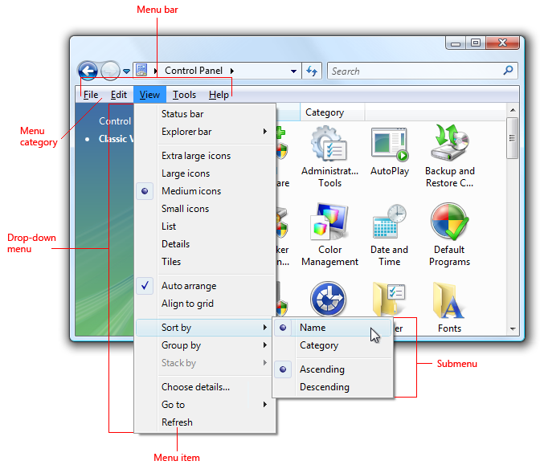

Slide 77
Create MenuBar object
MenuBar holds the menus.
MenuBar is added to frame with setMenuBar() method of Frame class.
Implicitly, the menu bar is added to the north (top) of the frame.
MenuBar cannot be added to other sides like south and west etc.
Declaration:
public class MenuBar extends MenuComponent
Constructor:
MenuBar()
Creates a new menu bar.

Slide 78
Menu add(Menu m) - Adds the specified menu to the menu bar.
void remove(int index)- Removes the menu located at the specified index from this menu bar.
void remove(MenuComponent m) - Removes the specified menu component from this menu bar.
void setHelpMenu(Menu m) – It sets the help menu on this menu bar to be given menu
Menu getHelpMenu() - Gets the help menu on the menu bar.
Menu getMenu(int i) - Gets the specified menu.
int getMenuCount()- Gets the number of menus on the menu bar.
Void deleteShortcut() – It deletes the given menu shortcut.
MenuItem getShortcutMenuItem(MenuShortcut s)
Gets the instance of MenuItem associated with the specified MenuShortcut object, or null if none of the menu items being managed by this menu bar is associated with the specified menu shortcut.

Slide 79
How to add menu bar in Frame
void setMenuBar(MenuBar mb)
Sets the menu bar for this frame to the specified menu bar.

Slide 80
Create MenuBar object
MenuBar: MenuBar holds the menus. MenuBar is added to frame with setMenuBar() method. Implicitly, the menu bar is added to the north (top) of the frame. MenuBar cannot be added to other sides like south and west etc.
Menu: Menu holds the menu items. Menu is added to frame with add() method. A sub-menu can be added to Menu.
MenuItem: MenuItem displays the actual option user can select. Menu items are added to menu with method addMenuItem(). A dull-colored line can be added in between menu items with addSeparator() method. The dull-colored line groups (or separates from other) menu items with similar functionality like cut, copy and paste.
CheckboxMenuItem: It differs from MenuItem in that it appears along with a checkbox. The selection can be done with checkbox selected.

Slide 81
Creating Menu Object
Declaration:
public class Menu extends MenuItem
Constructors:
Menu()
Constructs a new menu with an empty label.
Menu(String label)
Constructs a new menu with the specified label.
Menu(String label, boolean tearOff)---pop-up
Constructs a new menu with the specified label, indicating whether the menu can be torn off.

Slide 82
MenuItem add(MenuItem mi)
Adds the specified menu item to this menu.
void add(String label)
Adds an item with the specified label to this menu.
void addSeparator()
Adds a separator line, or a hypen, to the menu at the current position.
MenuItem getItem(int index)
Gets the item located at the specified index of this menu.
int getItemCount()
Get the number of items in this menu.
void insert(MenuItem menuitem, int index)
Inserts a menu item into this menu at the specified position.

Slide 83
void insert(String label, int index)
Inserts a menu item with the specified label into this menu at the specified position.
void insertSeparator(int index)
Inserts a separator at the specified position.
boolean isTearOff()
Indicates whether this menu is a tear-off menu.
void remove(int index)
Removes the menu item at the specified index from this menu.
void remove(MenuComponent item)
Removes the specified menu item from this menu.
void removeAll()
Removes all items from this menu.

Slide 84
MenuItem
Declaration
public class MenuItem extends MenuComponent
Constructors:
MenuItem()
Constructs a new MenuItem with an empty label and no keyboard shortcut.
MenuItem(String label)
Constructs a new MenuItem with the specified label and no keyboard shortcut.
MenuItem(String label, MenuShortcut s)
Create a menu item with an associated keyboard shortcut.

Slide 85
void deleteShortcut()
Delete any MenuShortcut object associated with this menu item.
protected void disableEvents(long eventsToDisable)
Disables event delivery to this menu item for events defined by the specified event mask parameter.
protected void enableEvents(long eventsToEnable)
Enables event delivery to this menu item for events to be defined by the specified event mask parameter
String getLabel()
Gets the label for this menu item.
MenuShortcut getShortcut()
Get the MenuShortcut object associated with this menu item,

Slide 86
boolean isEnabled()
Checks whether this menu item is enabled.
void setEnabled(boolean b)
Sets whether or not this menu item can be chosen.
void setLabel(String label)
Sets the label for this menu item to the specified label.
void setShortcut(MenuShortcut s)
Set the MenuShortcut object associated with this menu item.

Slide 87
MenuShortcut
Decclaration:
public class MenuShortcut extends Object
The MenuShortcutclass represents a keyboard accelerator for a MenuItem.
Menu shortcuts are created using virtual keycodes, not characters. For example, a menu shortcut for Ctrl-a (assuming that Control is the accelerator key) would be created with code like the following:
MenuShortcut ms = new MenuShortcut(KeyEvent.VK_A, false);
or alternatively
MenuShortcut ms = new MenuShortcut(KeyEvent.getExtendedKeyCodeForChar('A'), false);

Slide 88
Dialog Boxes
AWT support special window class-the Dialog class-that you can use to create dialog boxes.
The windows created with this class look more like standard dialog boxes than one you create with frame window.
Dialog boxes do not have minimize or maximize buttons
Dialog boxes are primarily used to obtain user input and are often child windows of a top-level window.
Dialog boxes don’t have menu bars, but in other respects, they function like frame windows.
You can add controls to them, for example, in the same way that you add controls to a frame window.

Slide 89
Dialog boxes may be modal or modeless.
When a modal dialog box is active, all input is directed to it until it is closed. This means that you cannot access other parts of your program until you have closed the dialog box.
When a modeless dialog box is active,input focus can be directed to another window in your program. Thus, other parts of your program remain active and accessible.
Dialog boxes are of type Dialog

Slide 90
Constructors of Dialog class
Dialog(Frame owner)
Constructs an initially invisible, modeless Dialog with the specified owner Frame and an empty title.
Dialog(Frame owner, boolean modal)
Constructs an initially invisible Dialog with the specified owner Frame and modality and an empty title.
Dialog(Frame owner, String title)
Constructs an initially invisible, modeless Dialog with the specified owner Frame and title.
Dialog(Frame owner, String title, boolean modal)
Constructs an initially invisible Dialog with the specified owner Frame, title and modality.

Slide 91
String getTitle()
Gets the title of the dialog.
void setBackground(Color bgColor)
Sets the background color of this window.
void setModal(boolean modal)
Specifies whether this dialog should be modal.
void setResizable(boolean resizable)
Sets whether this dialog is resizable by the user.
void setTitle(String title)
Sets the title of the Dialog.
void setVisible(boolean b)
Shows or hides this Dialog depending on the value of parameter b.

Slide 92
FileDialog
We can use AWT class FileDialog to create and display the dialog boxes that let the user browse directories and select files.
Public class FileDialog extends Dialog
Java provides a built-in dialog box that lets the user specify a file.
To create a file dialog box, instantiate an object of type FileDialog.
public static final int LOAD 0
This constant value indicates that the purpose of the file dialog window is to locate a file from which to read.
public static final int SAVE 1
This constant value indicates that the purpose of the file dialog window is to locate a file to which to write.

Slide 93
FileDialog(Dialog parent)
Creates a file dialog for loading a file.
FileDialog(Dialog parent, String title)
Creates a file dialog window with the specified title for loading a file.
FileDialog(Dialog parent, String title, int mode)
Creates a file dialog window with the specified title for loading or saving a file.
FileDialog(Frame parent)
Creates a file dialog for loading a file.
FileDialog(Frame parent, String title)
Creates a file dialog window with the specified title for loading a file.
FileDialog(Frame parent, String title, int mode)
Creates a file dialog window with the specified title for loading or saving a file.

Slide 94
String getDirectory()
Gets the directory of this file dialog.
String getFile()
Gets the selected file of this file dialog.
File[] getFiles()
Returns files that the user selects.
int getMode()
Indicates whether this file dialog box is for loading from a file or for saving to a file.
boolean isMultipleMode()
Returns whether the file dialog allows the multiple file selection.
void setDirectory(String dir)
Sets the directory of this file dialog window to be the specified directory.
void setFile(String file)
Sets the selected file for this file dialog window to be the specified file.
void setMode(int mode)
Sets the mode of the file dialog.
void setMultipleMode(boolean enable)
Enables or disables multiple file selection for the file dialog.

Slide 95
FileDialogDemo.java

